Slide 1
Computer Vision
Rubén Ferreiroa

Slide 2










Aula Virtual UIE

Slide 3


Slide 4


Participar

Slide 5
03
II
Digital Image Fundamentals

Slide 6
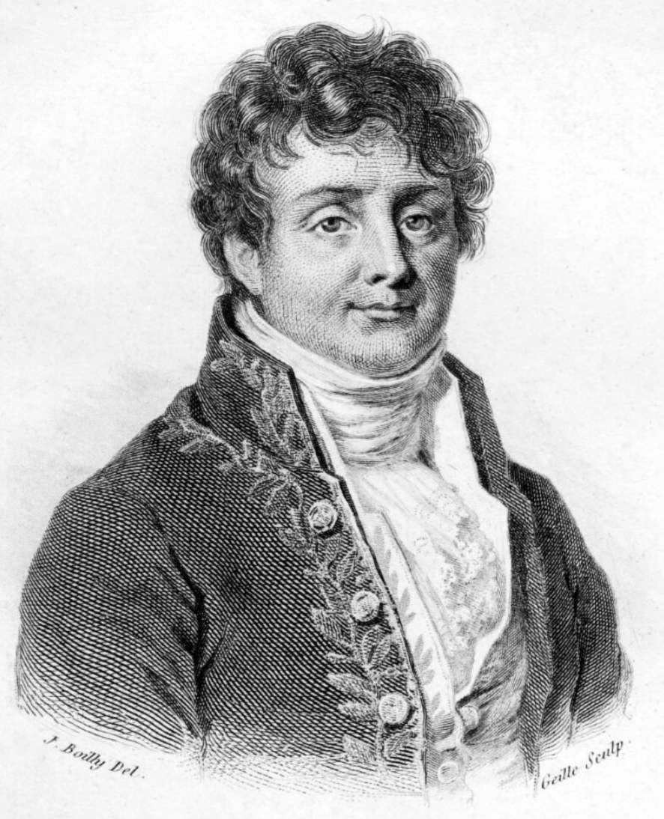
Jean Baptiste Joseph Fourier (1768-1830)
Hard crazy idea (1807):
Any periodic function can be rewritten as a weighted sum of sines and cosines of different frequencies.

Slide 7
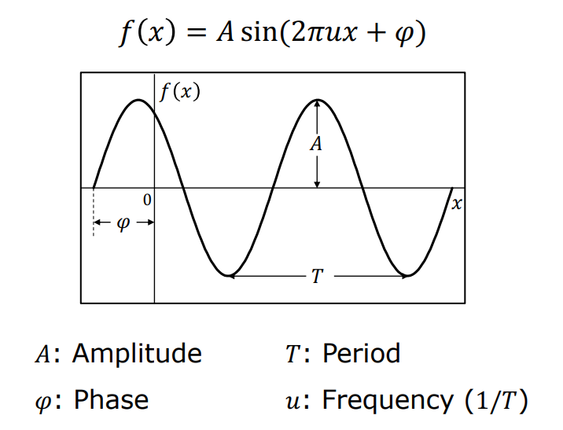
A sum of sines
Our building block

Slide 8
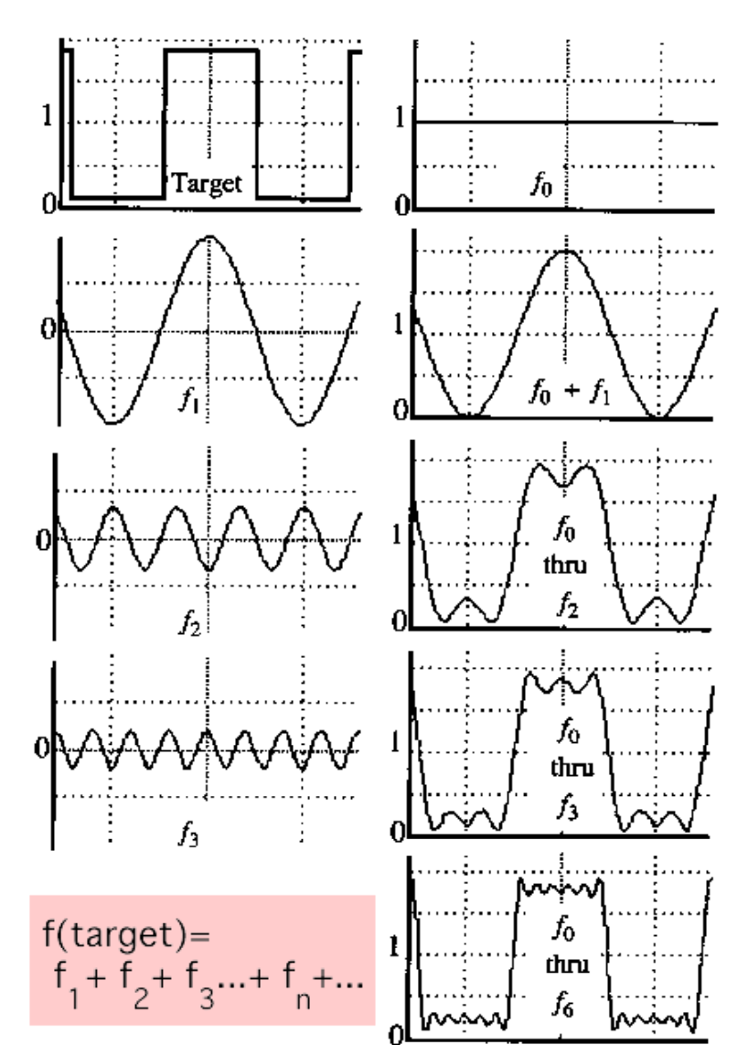
A sum of sines
Add enough of them to get any signal f(x) you want!
Which one encodes the coarse vs. fine structure of the signal?

Slide 9
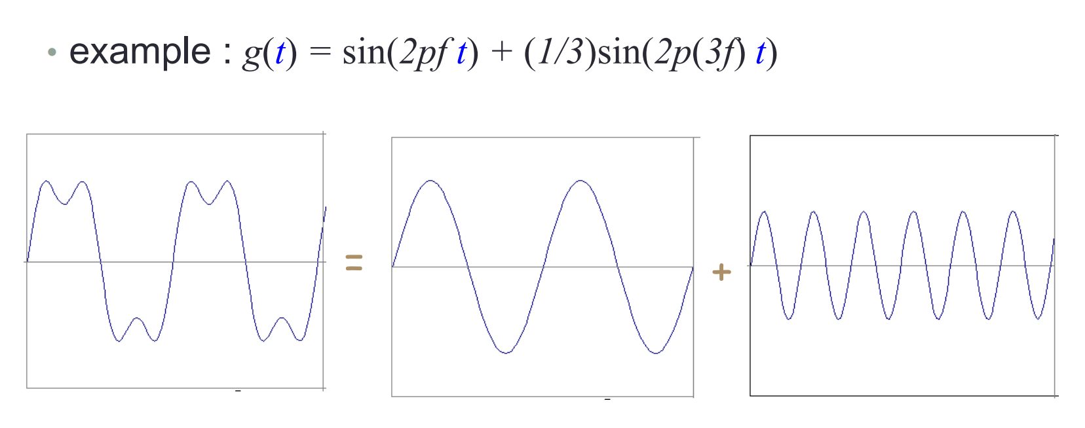
Time and Frecuency

Slide 10
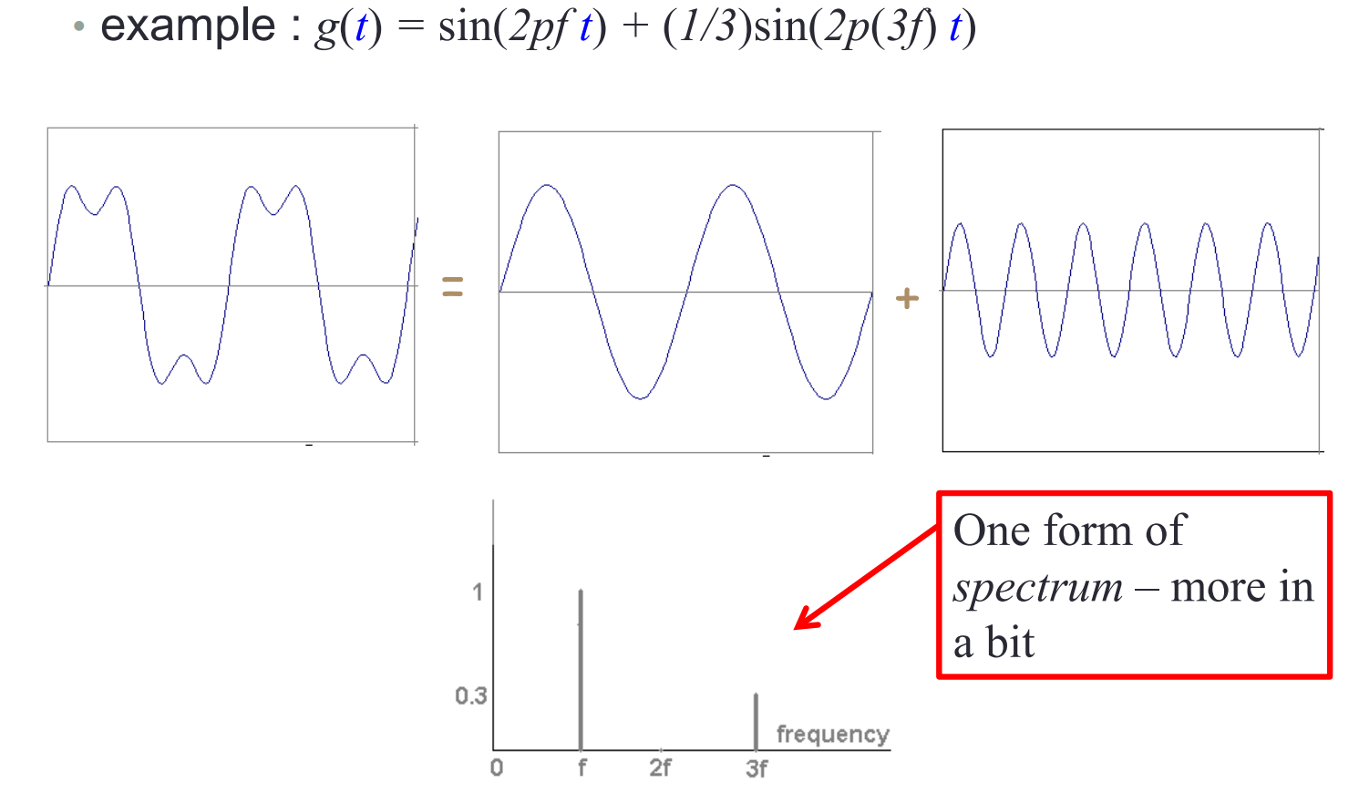
Frecuency Spectra - Series

Slide 11
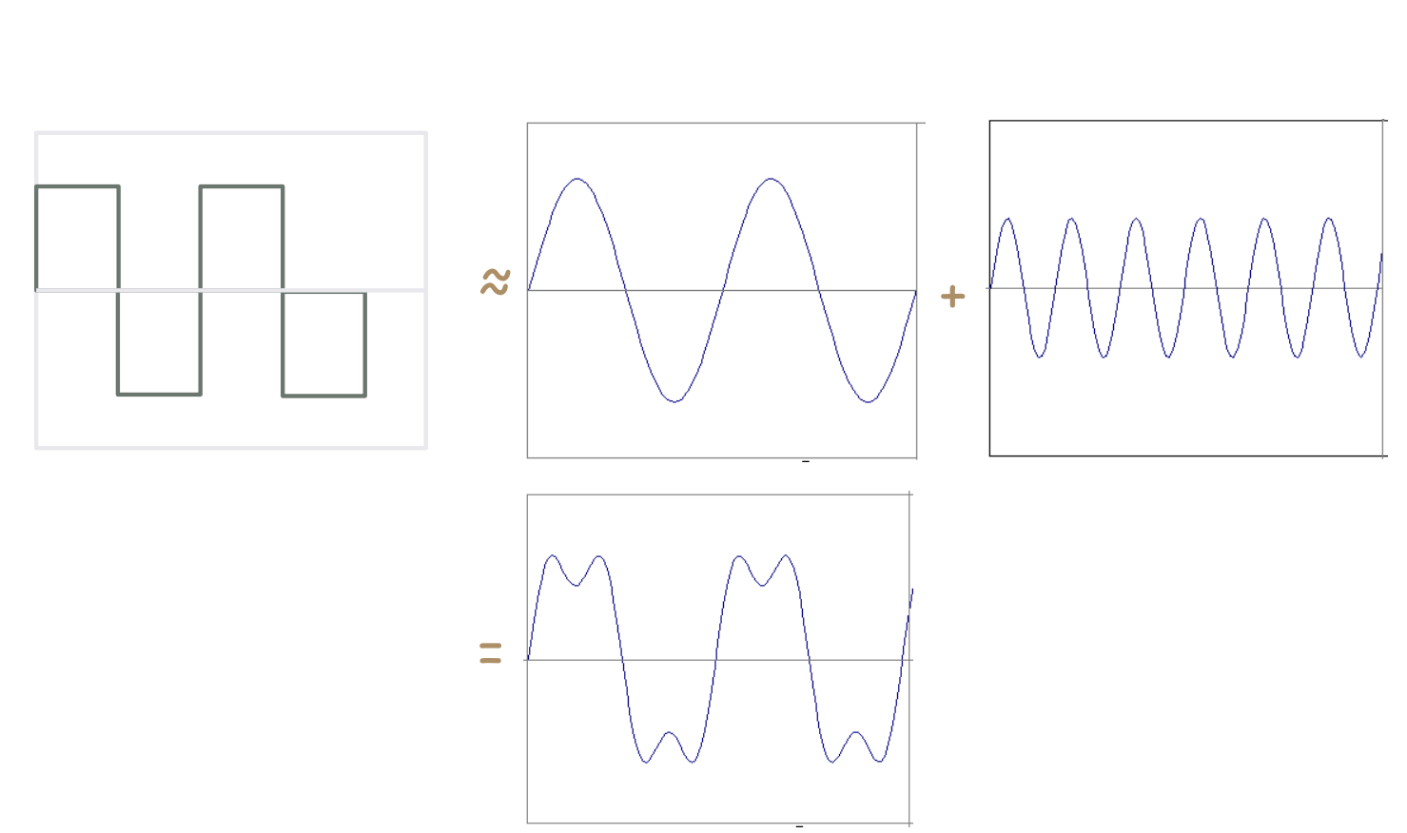
Frecuency Spectra - Series

Slide 12
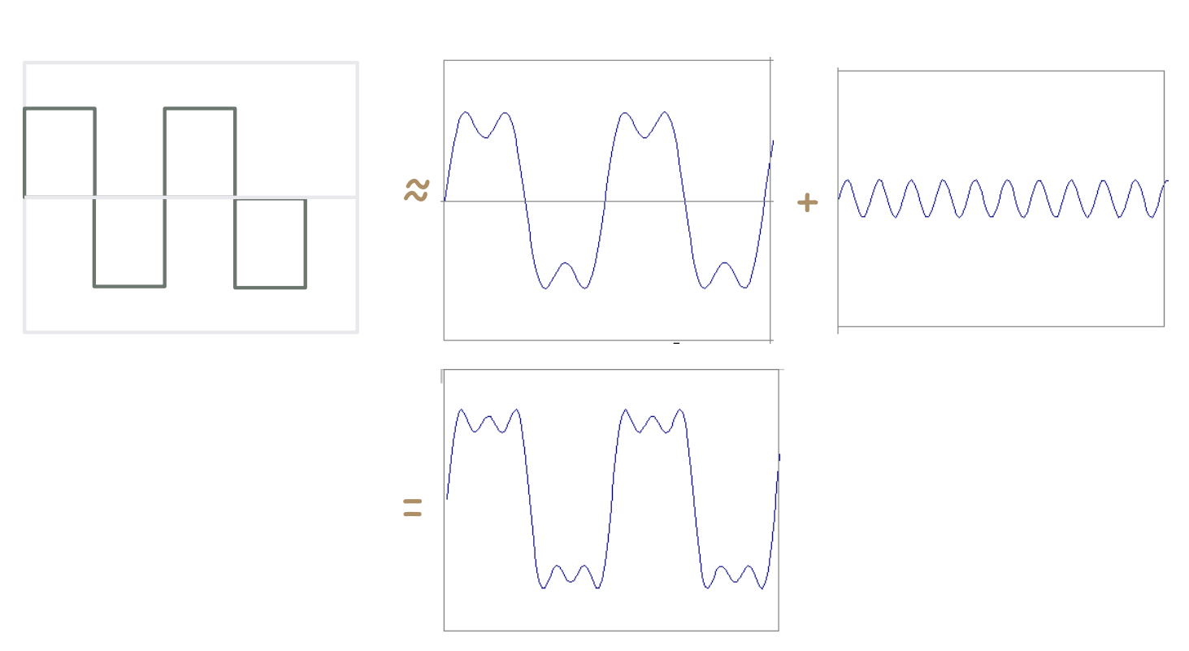
Frecuency Spectra - Series

Slide 13
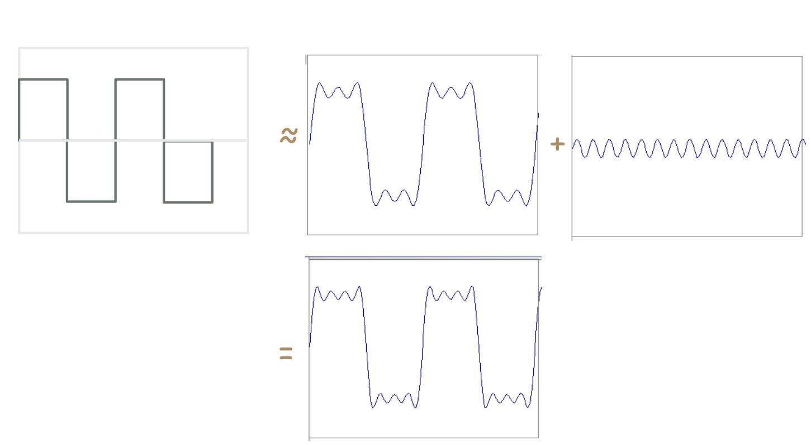
Frecuency Spectra- Series

Slide 14
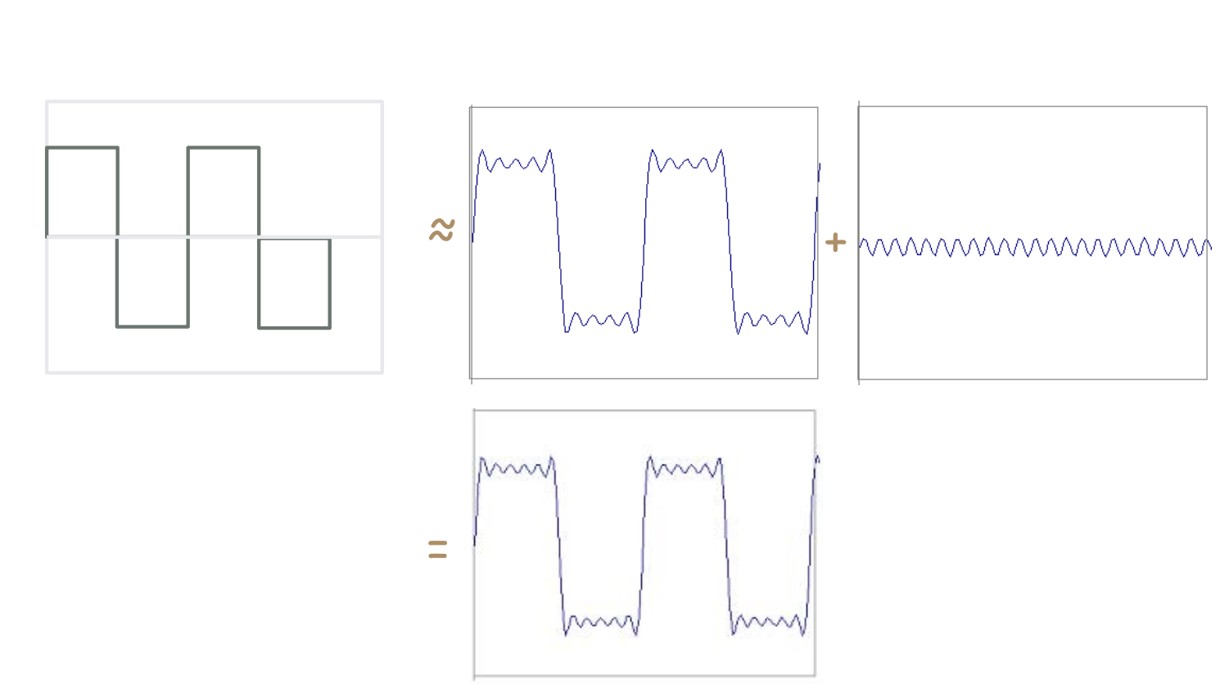
Frecuency Spectra - Series

Slide 15
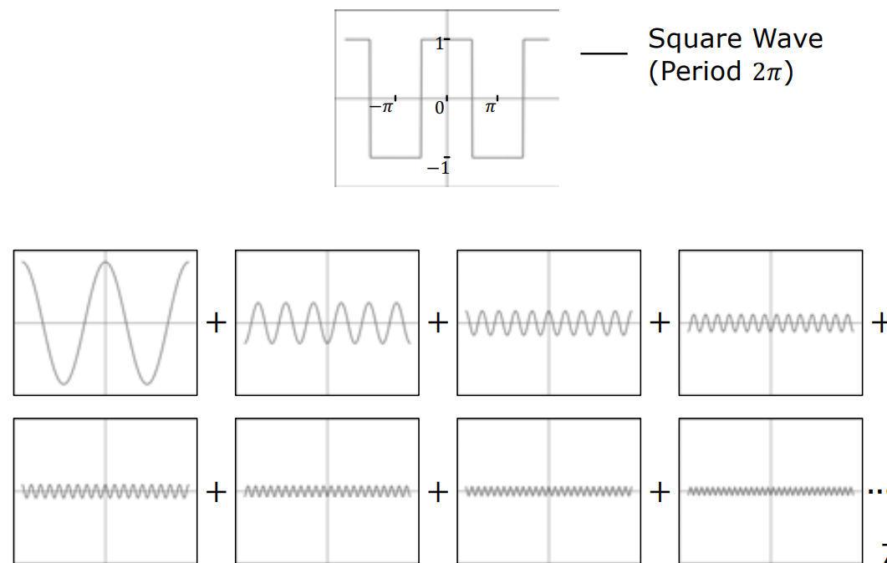
Fourier Series

Slide 16
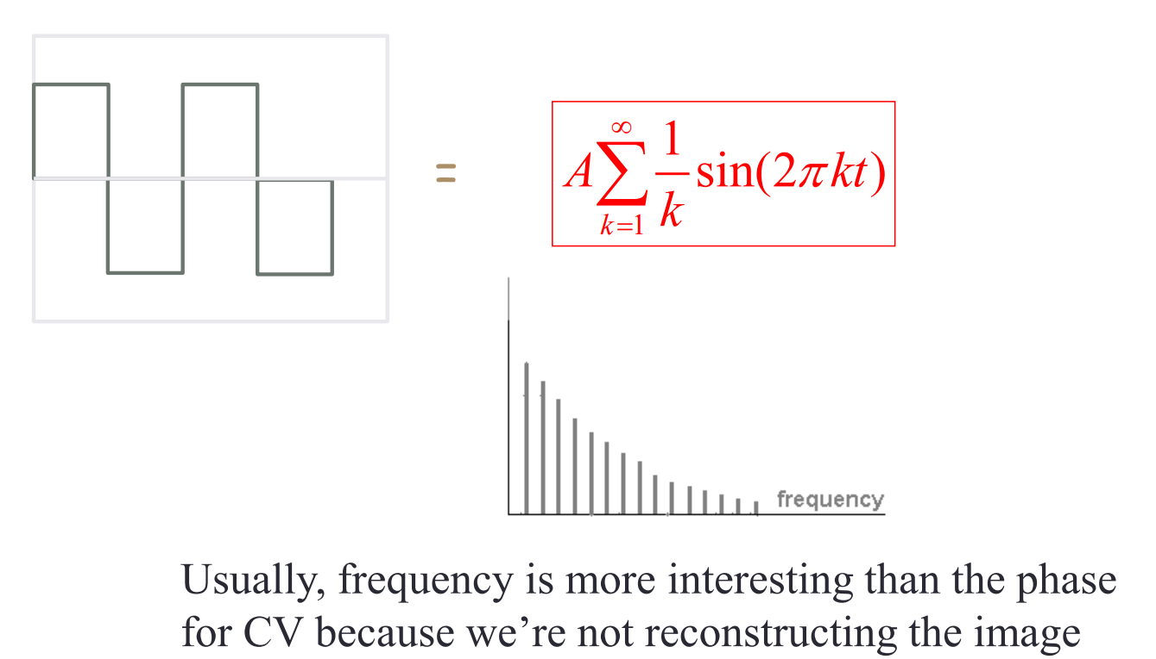
Frecuency Spectra - Series

Slide 17
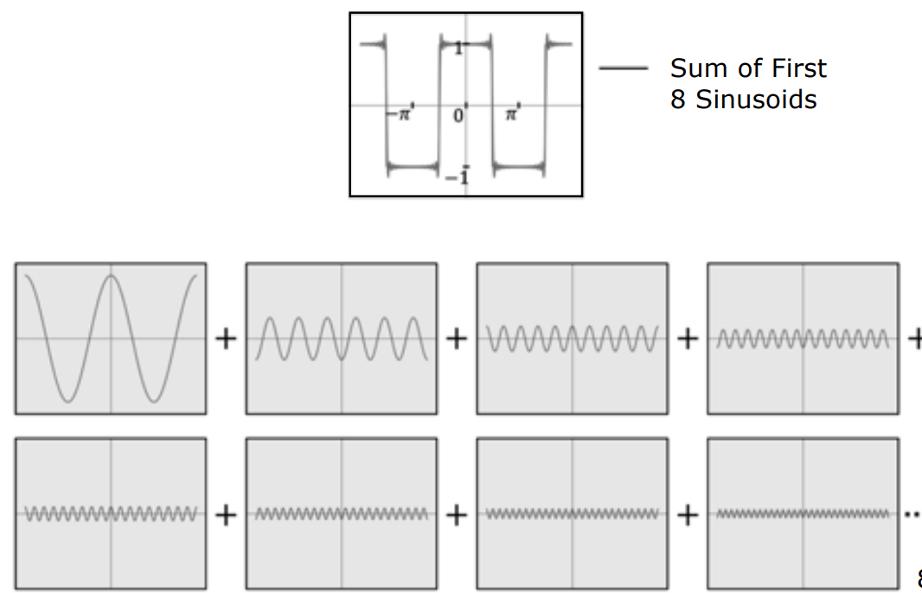
Fourier Series

Slide 18
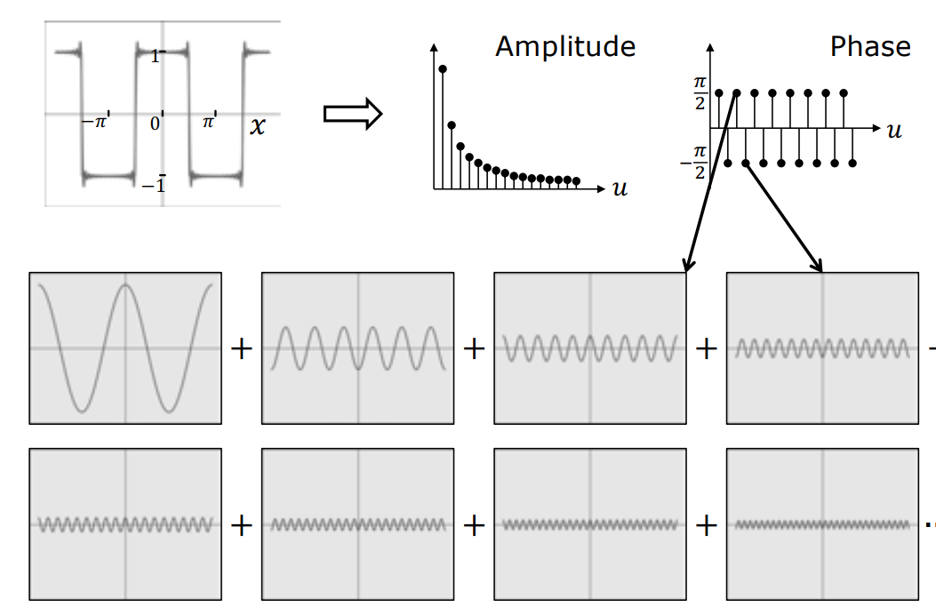
Frecuency Representation of Signal

Slide 19
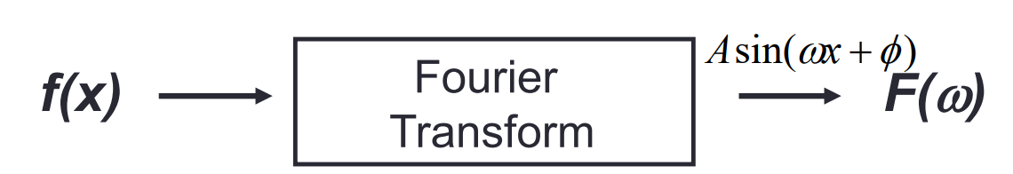
Fourier Transform (FT)
We want to understand the frequency ω of our signal. So, let’s reparametrize the signal by ω instead of x:
For every ω from 0 to inf (actually –inf to inf), F(ω) holds the amplitude A and phase φ of the corresponding sine

Slide 20
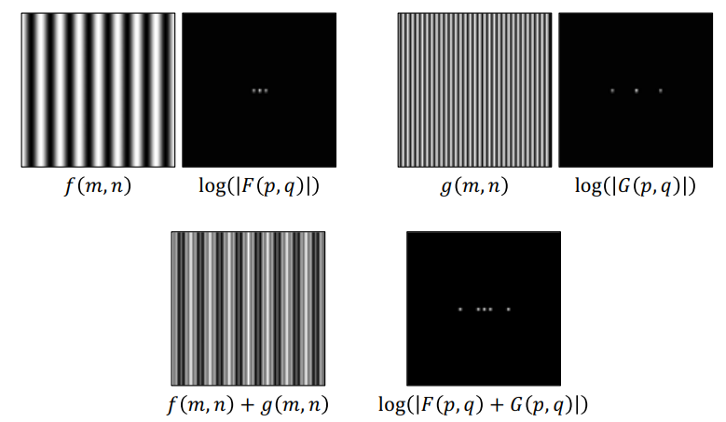
Image Filtering in Frequency Domain
Top left image. It shows a pattern of vertical lines representing a cosine function in the x direction. When we apply the Fourier transform to this pattern, we get something fascinating: three dots in a horizontal line. Why three dots? Because the Fourier transform of a cosine gives us two frequencies (k and -k), plus a central point representing the average image intensity (128 in this case, as we're working with values between 0 and 256).
2D Fourier Transform: Example 1
Top right image. we see another cosine pattern, but with lines closer together - meaning a higher frequency. That's why in its transform, the dots are more spread apart.
The most interesting part comes at the bottom. When we combine both cosine patterns (adding them together), we get a new pattern that mixes both frequencies. Its Fourier transform reflects this combination by showing five dots: the central intensity point, and two pairs of dots, each pair corresponding to one of the original frequencies.

Slide 21
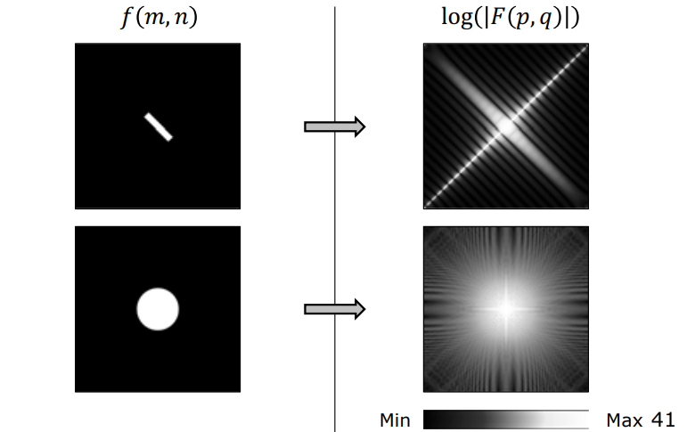
Image Filtering in Frequency Domain
2D Fourier Transform: Example 2
The first image is a bar. As we can see, we get very strong frequencies
along two lines. That is because we have two pairs
of strong edges and to re-create each edge we
need frequencies in the direction perpendicular to
the edge.
The second image is that of a disk. The flat part of the disk produces some low frequencies. Again, the edges produce high frequencies. Note that since the image is rotationally symmetric, its Fourier transform is rotationally symmetric as well.

Slide 22
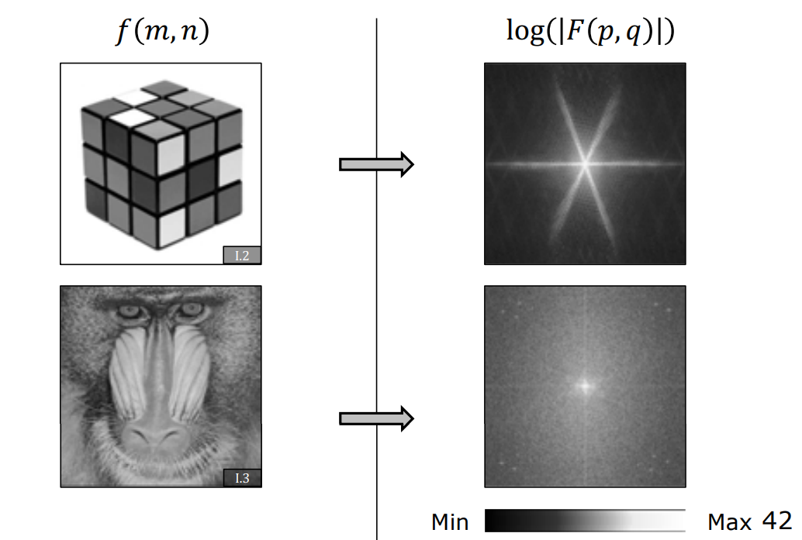
Image Filtering in Frequency Domain
2D Fourier Transform: Example 3
Moving to more natural images, here we have a Rubik’s cube on the top. In this case, we see that we get three strong lines in the Fourier transform, indicating high frequencies along these lines. This is because the original image has edges along three dominant directions: vertical edges, horizontal edges, and slanted edges.
In the case of the Mandrill, there is not really much that can be said. Since the image is complex it is hard to interpret its transform. As humans, we are not wired to easily interpret signals in frequency domain.

Slide 23
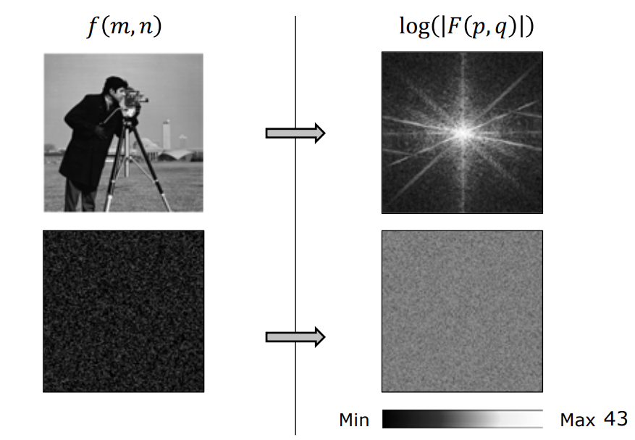
Image Filtering in Frequency Domain
2D Fourier Transform: Example 4
Here is a more complex image with lots of strong edges. The second example is an image which is just noise. In this case we see that we get very strong values in the Fourier transform, even for high frequencies. As we will see soon, this makes the removal of noise from images a challenging problem.

Slide 24
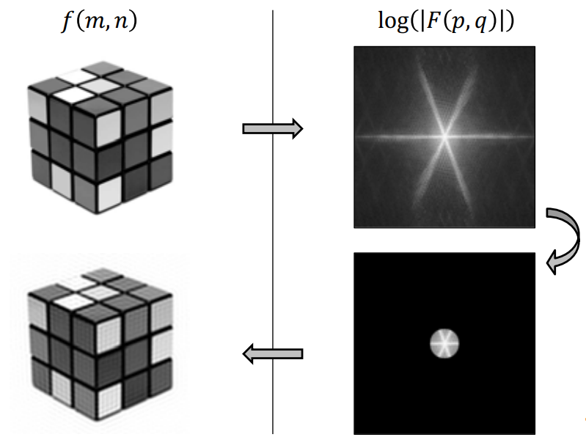
Image Filtering in Frequency Domain
Low Pass Filtering
Now let us take a look at some simple types of filtering. Taking the Fourier transform of the image of the Rubik’s cube, we get the same output we saw earlier. If we want to low-pass filter this image, we can simply cut out the outer parts of the Fourier transform. Taking the inverse Fourier transform, we see that we get a blurrier
(smoother) version of the image. This image has some block artifacts, and that is because we have done a very harsh low-pass filtering — the sharp boundary of the cut-out region causes the artifacts.

Slide 25
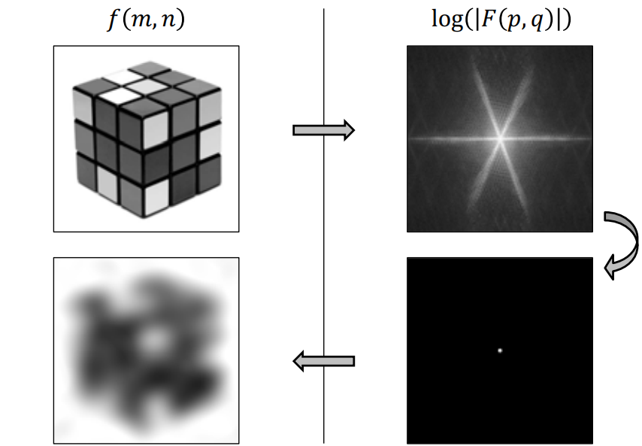
Image Filtering in Frequency Domain
Low Pass Filtering
If we more severely low-pass filter this image, meaning we use a smaller cut-out region in frequency domain, as expected, we get an even blurrier image.

Slide 26
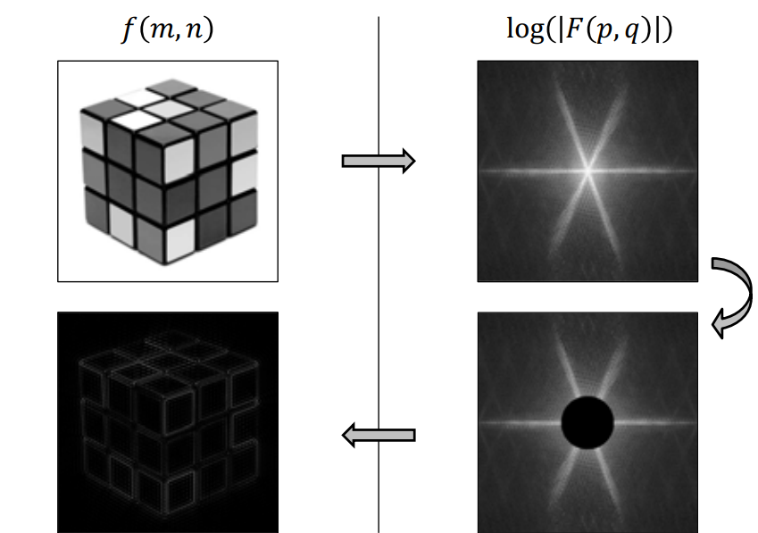
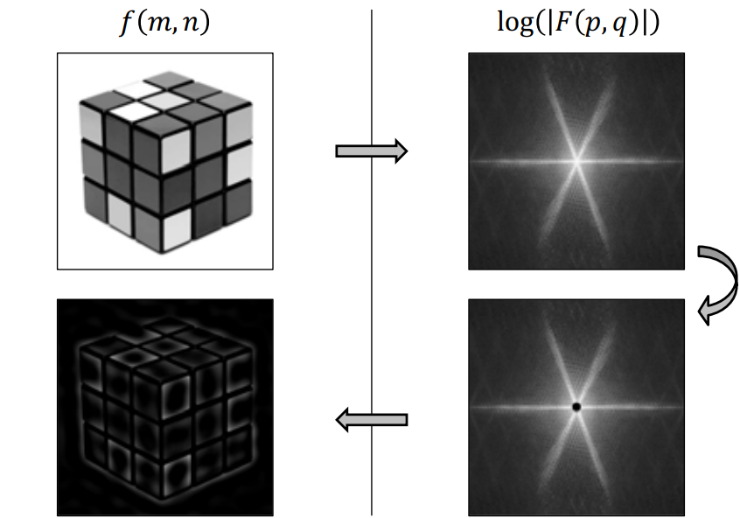
Image Filtering in Frequency Domain
High Pass Filtering
We can also do the opposite, which is high-pass filter the image. Here we have the Fourier transform again, but now we are going to eliminate the low frequencies and keep the high frequencies. When we do that, we see that we essentially remove all of the constant brightness regions in the image, leaving us with the regions where there is a rapid change in brightness. If we increase the severity of our high pass filtering by using the larger cutout on the right, we see that the edges and corners begin to appear more prominent.

Slide 27
EXERCISES

Slide 28
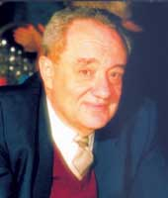
Wavelet
Jean Morlet (French: 13 January 1931 – 27 April 2007) was a French geophysicist who pioneered work in the field of wavelet analysis around the year 1975

Slide 29
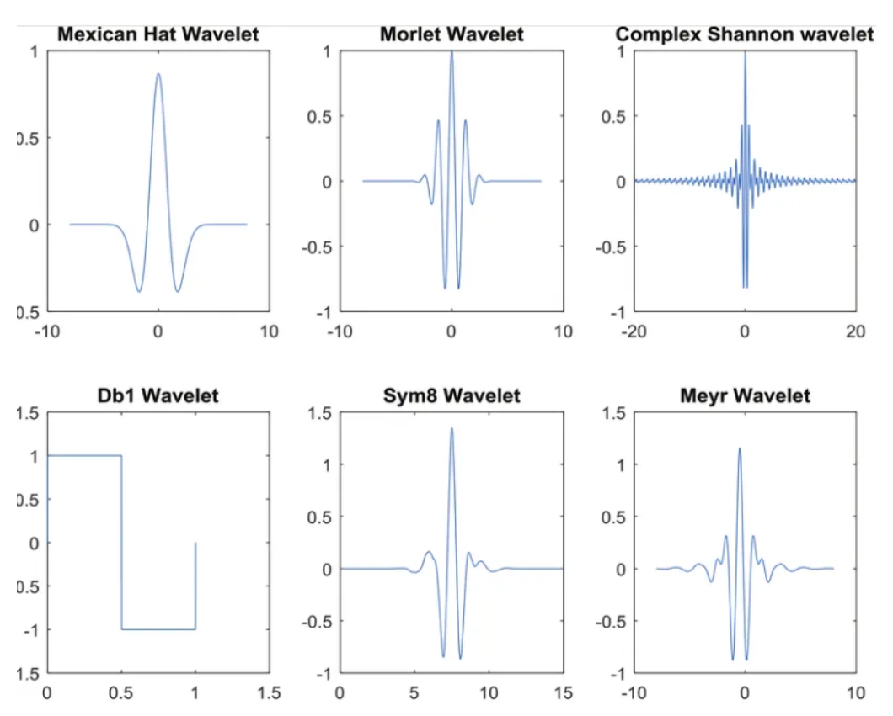
What is a Wavelet?
A wavelet is a wave-like oscillation, which is a “brief oscillation” or “small oscillation”. Its amplitude begins at zero, increases or decreases, and then returns to zero one or more times. Let’s see some wavelets plots as follows:

Slide 30
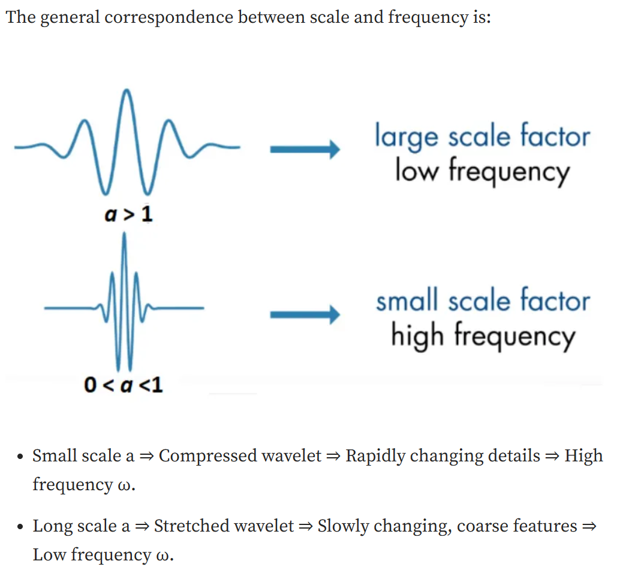
Wavelet Transform
In the signal processing context, Wavelet transform (WT), also called wavelet analysis, is a method to decompose an input signal of interest into a set of elementary waveforms, i.e. “wavelets”
Wavelet Transform (WT) provides a way to analyze the signal by examining the coefficients (or weights) of these wavelets.
Two basic factors
scale (or dilation): Stretched or compressed (or shrunk) wavelet
shift (or location): the positions of the wavelet

Slide 31
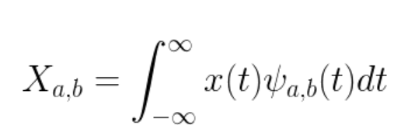
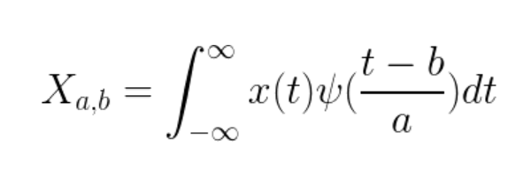
The General Form of Wavelet Formula
a is the scale and b is the translation

Slide 32
Wavelet transform decomposes a time series into waves that are localized not only in frequency but also in time.

Slide 33
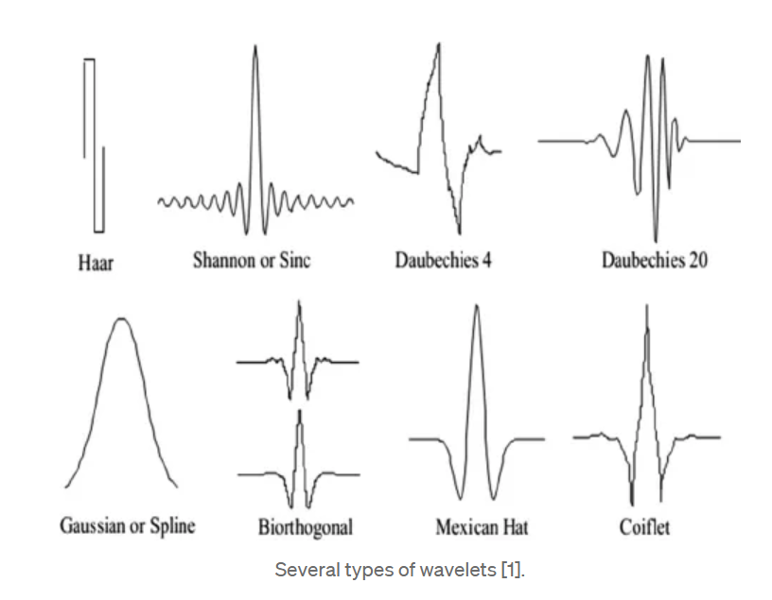
Types of wavelets
In Wavelet Analysis we scale the wavelet function to different sizes and convolve it with the input signal. This is called a Wavelet Transform and allows us to represent the signal in terms of different scales of the wavelet. Wavelet transforms allow us to capture spatial and temporal information of the signal.

Slide 34
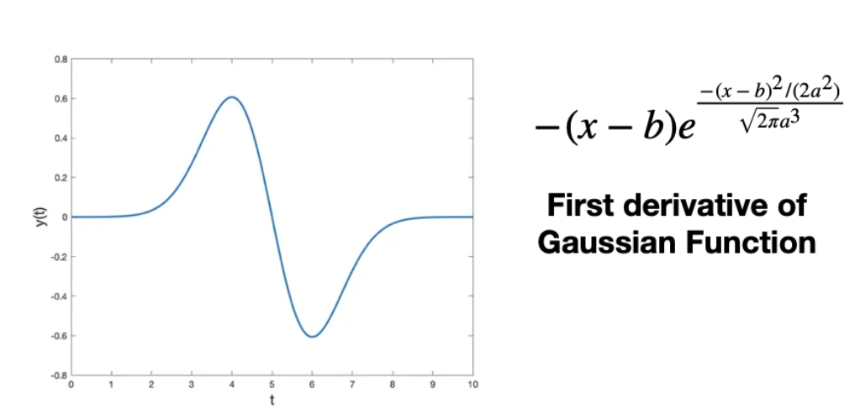
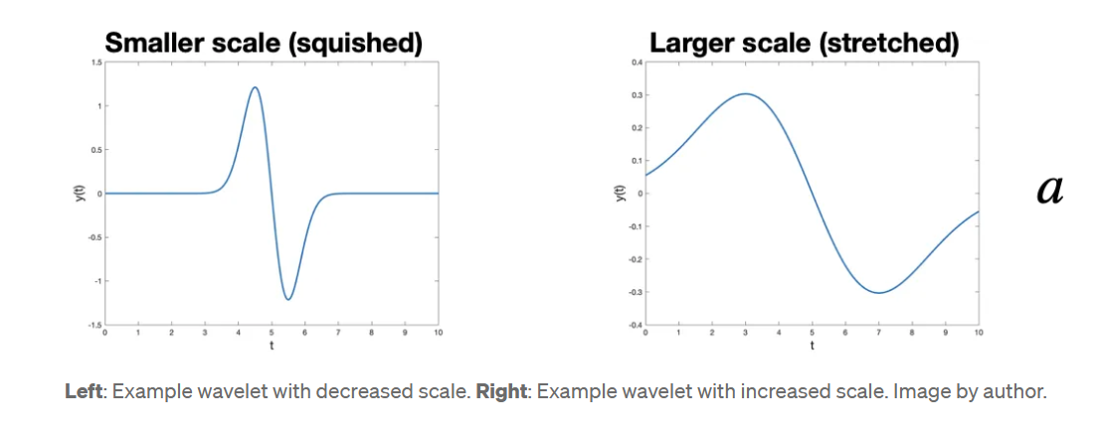
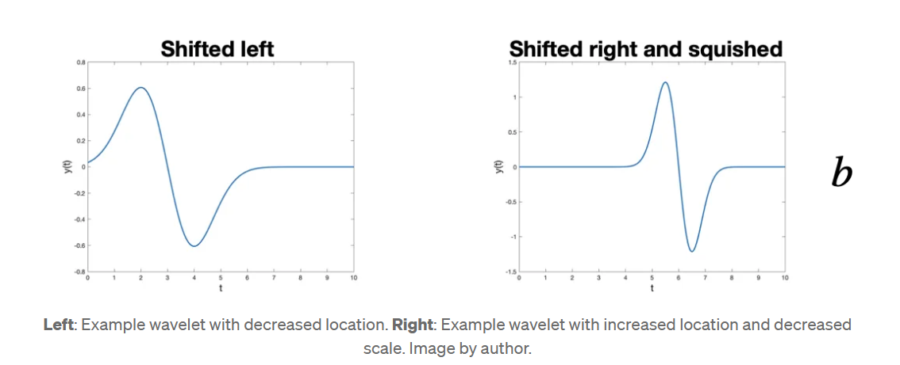
How does it work?
The basic idea is to compute how much of a wavelet is in a signal for a particular scale and location. For those familiar with convolutions, that is exactly what this is. A signal is convolved with a set wavelets at a variety of scales.
In other words, we pick a wavelet of a particular scale (like the blue wavelet in the gif above). Then, we slide this wavelet across the entire signal i.e. vary its location, where at each time step we multiply the wavelet and signal. The product of this multiplication gives us a coefficient for that wavelet scale at that time step. We then increase the wavelet scale (e.g. the red and green wavelets) and repeat the process.

Slide 35
Why wavelets?
A couple of key advantages of the Wavelet Transform are:
Wavelet transform can extract local spectral and temporal information simultaneously
Variety of wavelets to choose from

Slide 36
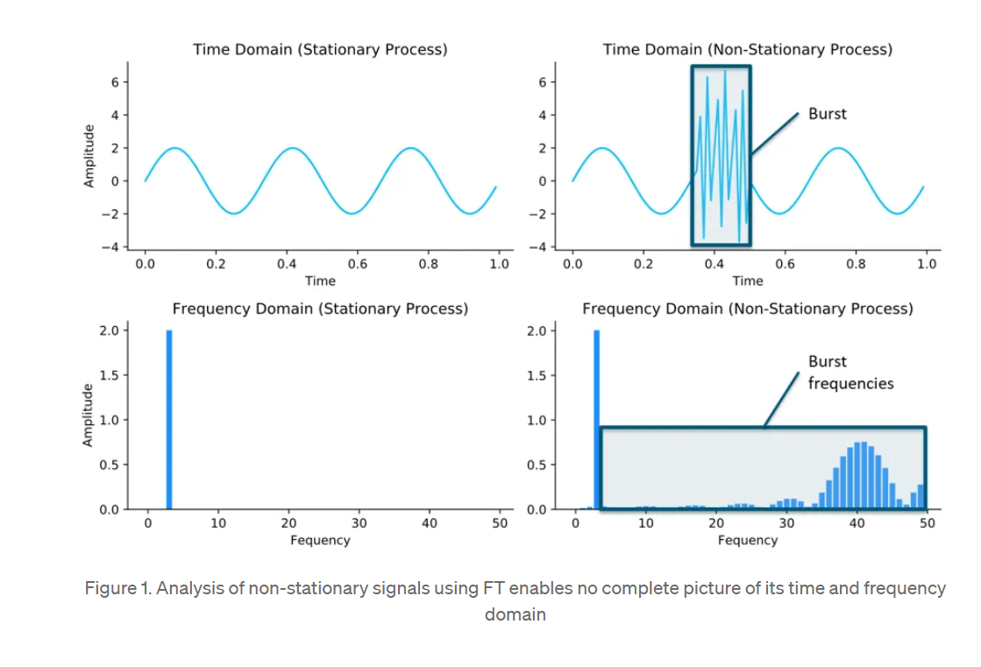
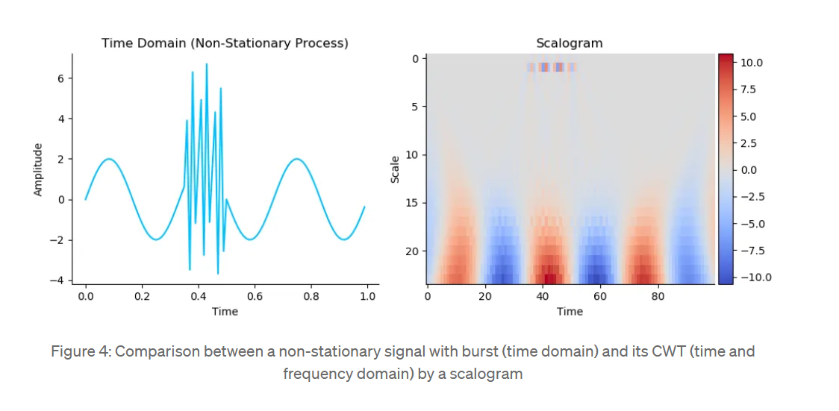
Comparision Fourier and Wavelet
Wavelet transform can extract local spectral and temporal information simultaneously Fourier transform NO

Slide 37
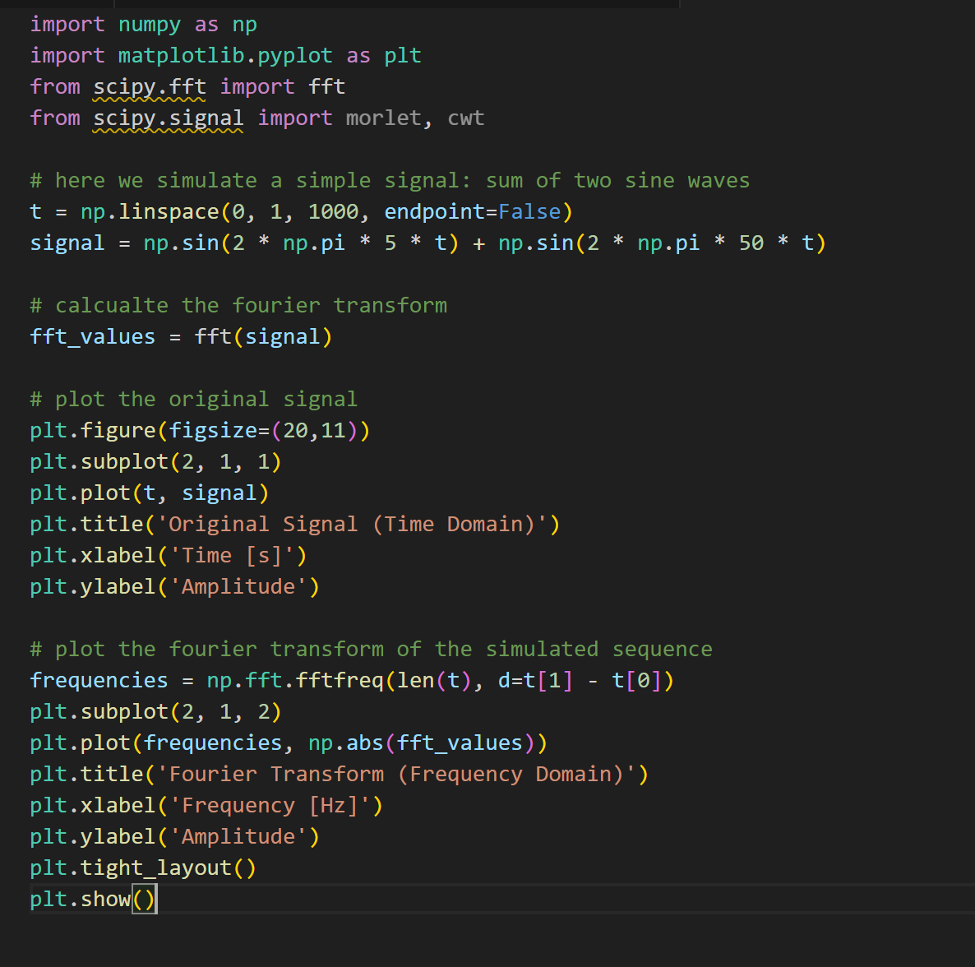
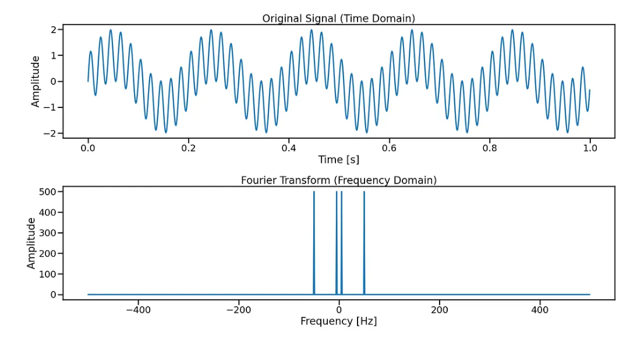
Compare the results of a Fourier transform and a wavelet transform using Python

Slide 38
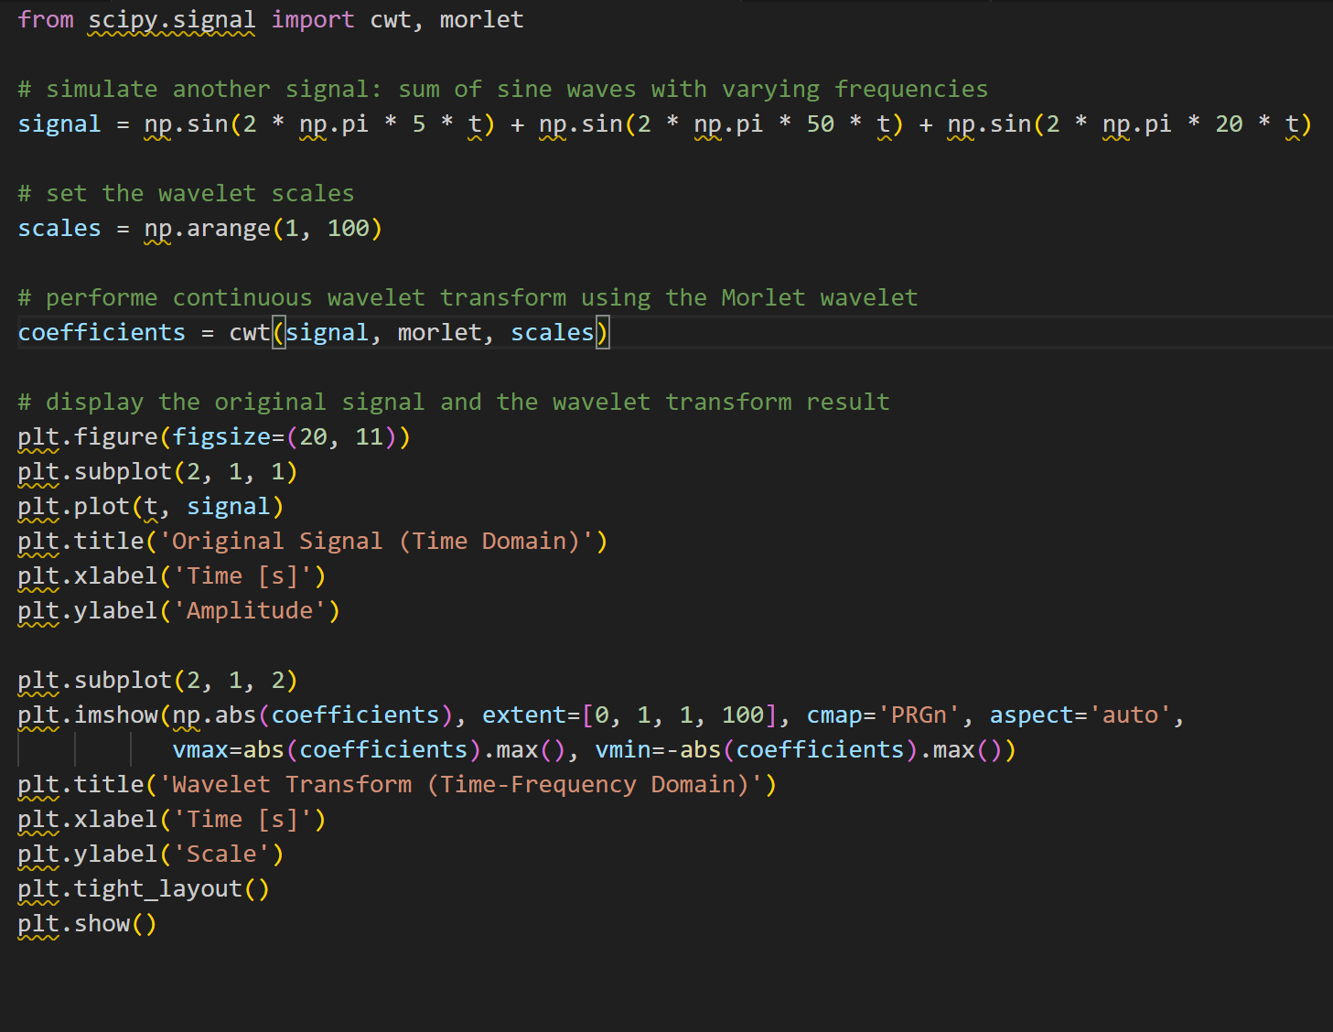
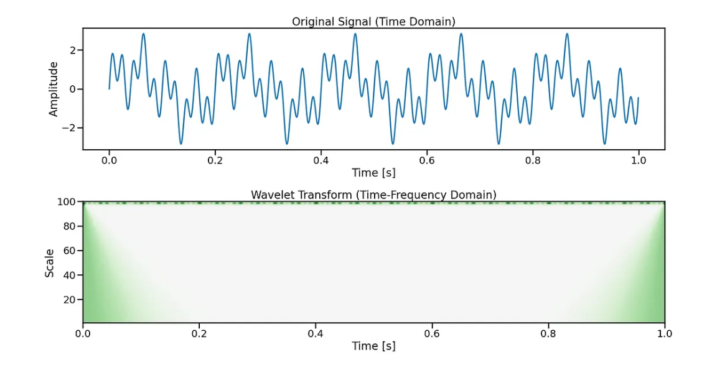
Compare the results of a Fourier transform and a wavelet transform using Python

Slide 39
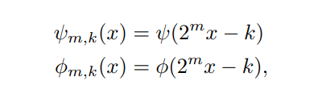
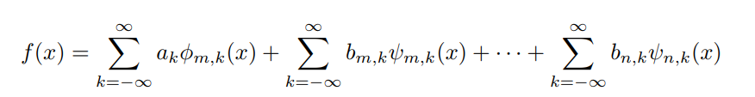
The discrete wavelet transform is analogous to the discrete Fourier transform. Now, instead of using trigonometric functions, different families of basis functions are used. A function called the wavelet or mother wavelet, usually denoted ψ, and another function called the scaling or father scaling function, typically represented by φ, are the basis of a wavelet family.
where m < n and all but a finite number of the ak and bj,k terms are nonzero. The ak terms are often referred to as approximation coefficients while the bj,k terms are known as detail coefficients.
The approximation coefficients typically capture the broader, more general features of a signal while the detail coefficients capture smaller details and noise. Depending on the properties of the wavelet and the function (or signal), f can be approximated to an arbitrary level of accuracy.

Slide 40
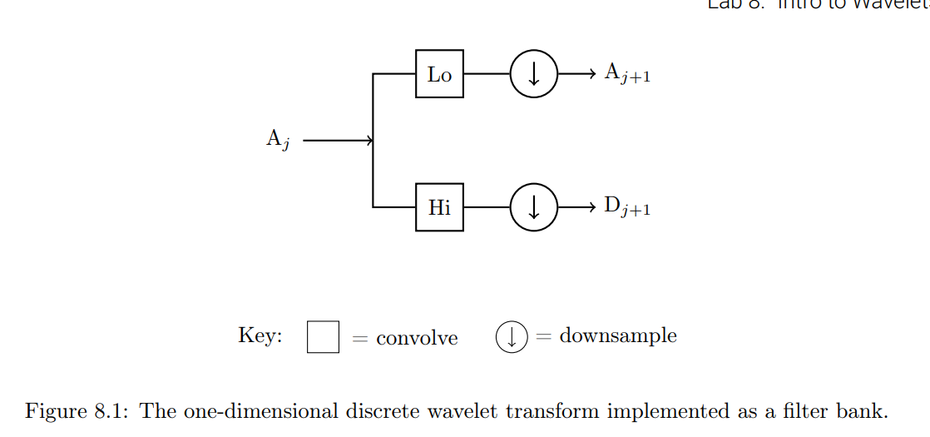
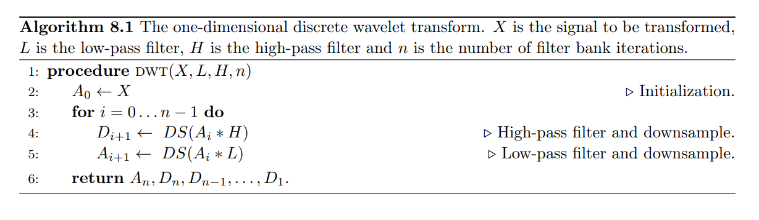
one-dimensional discrete wavelet transform

Slide 41
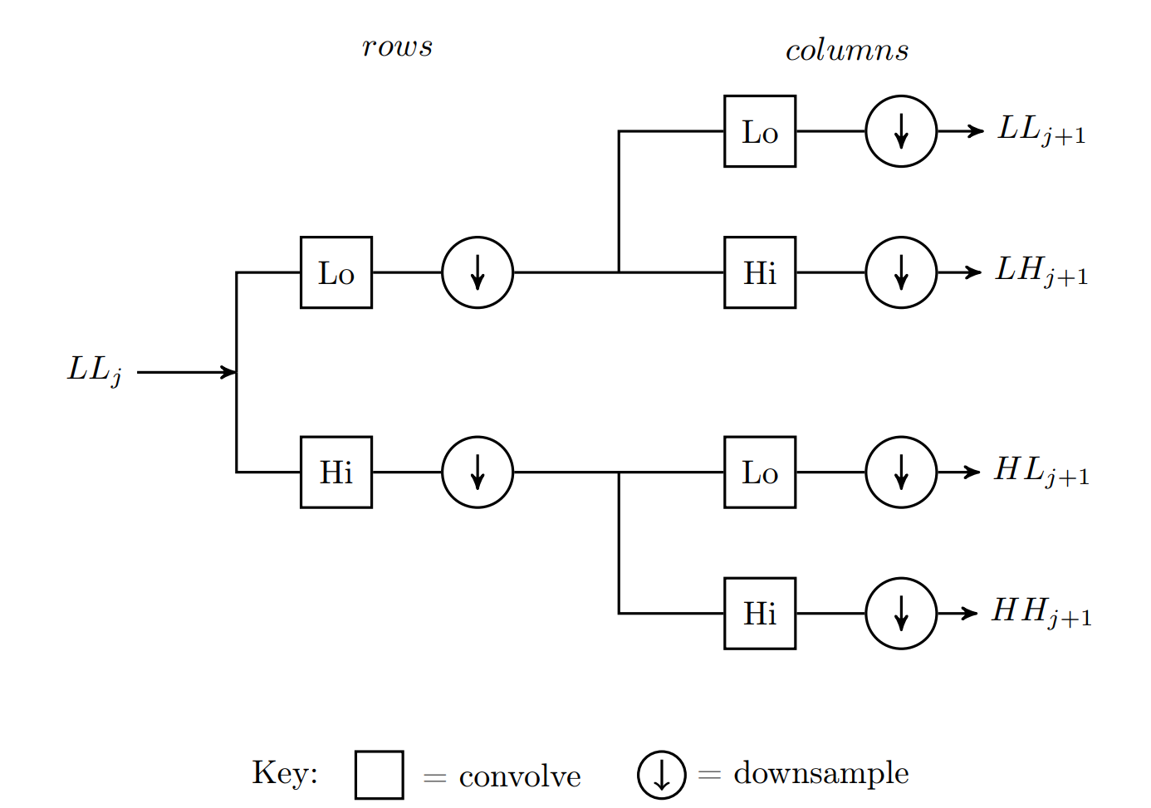
Two-dimensional Wavelet Transform
Descomposición en Subbandas:
LL (Low-Low): Aproximación de la imagen (componentes de baja frecuencia)
LH (Low-High): Detalles horizontales
HL (High-Low): Detalles verticales
HH (High-High): Detalles diagonales
Proceso de Descomposición:
Se aplican filtros paso bajo (L) y paso alto (H) en las filas
Luego se aplican en las columnas
Resulta en cuatro subbandas (LL, LH, HL, HH)
Cada subbanda es 1/4 del tamaño original
Descomposición Multinivel:
La subbanda LL puede descomponerse nuevamente
Cada nivel proporciona información a diferentes escalas
El número de niveles depende del tamaño de la imagen

Slide 42
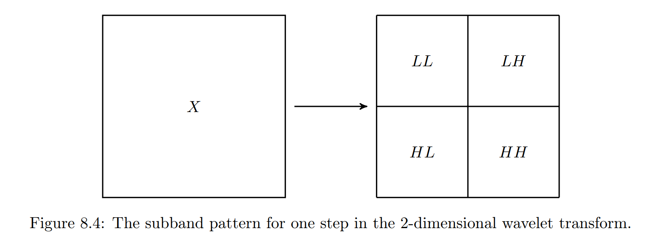
Two-dimensional Wavelet Transform
Two dimensional array X is the input to the filter bank, the arrays LL, LH, HL, and HH are obtained. LL is a smoothed approximation of X (similar to An in the one-dimensional case) and the other three arrays contain wavelet coefficients capturing high-frequency oscillations in vertical, horizontal, and diagonal directions. The arrays LL, LH, HL, and HH are known as subbands.

Slide 43
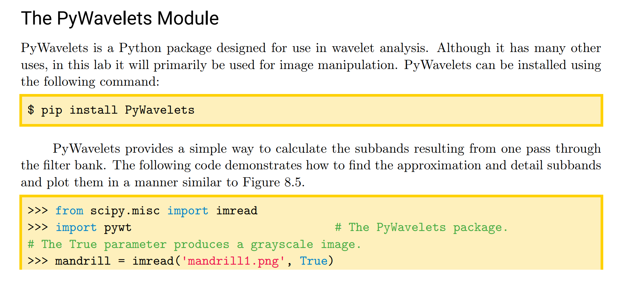

Slide 44
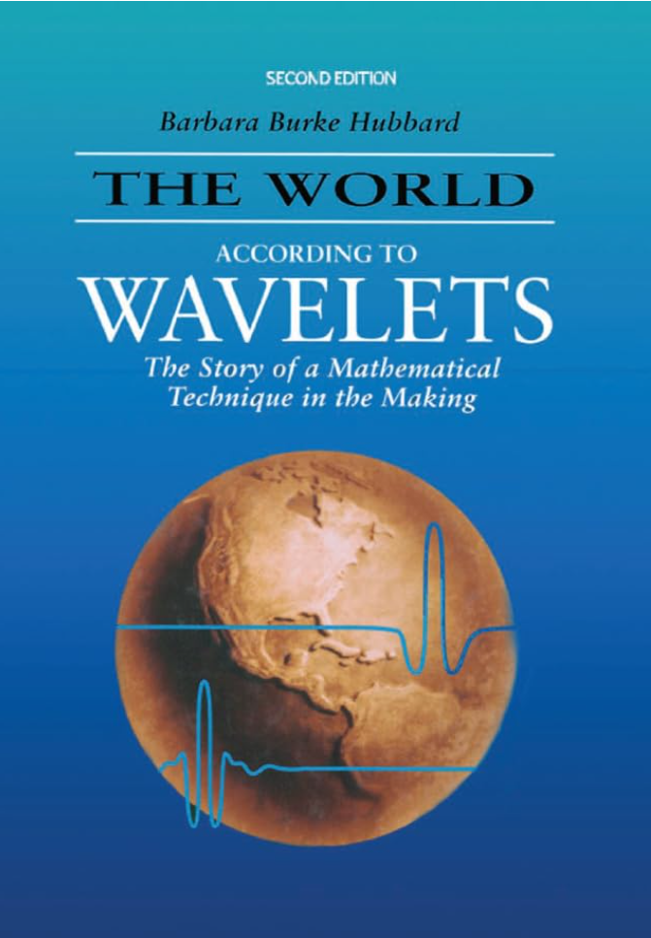

Slide 45
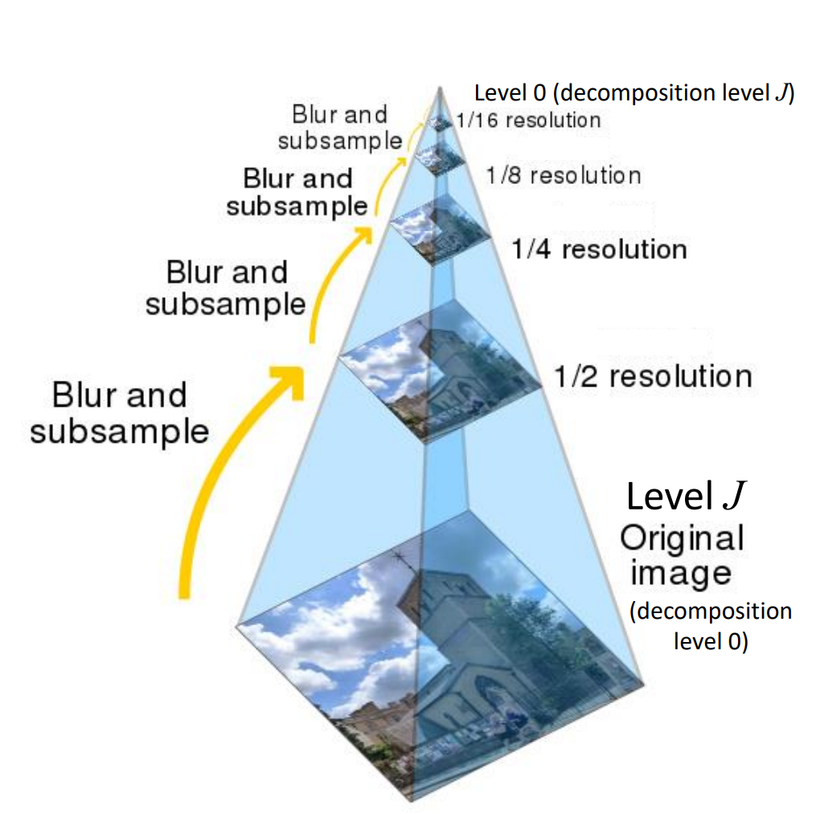
Wavelet
What are image pyramids?
An “image pyramid” is a multi-scale representation of an image
Utilizing an image pyramid allows us to find objects in images at different scales of an image.
At the bottom of the pyramid we have the original image at its original size (in terms of width and height). And at each subsequent layer, the image is resized (subsampled) and optionally smoothed (usually via Gaussian blurring).
The image is progressively subsampled until some stopping criterion is met, which is normally a minimum size has been reached and no further subsampling needs to take place.
HANDS ON

